Slide 1
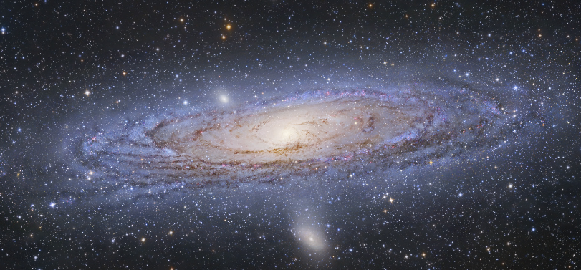
The Universe
The universe is a big place, perhaps the biggest. –Kurt Vonnegut
This is a spiral galaxy with other galaxies in the background. The universe is “everything that exists.”

Slide 2
Cosmology
Cosmology is the study of the nature of the universe, how the universe began and how it will end, if it does
There is religious cosmology, and scientific cosmology
“Creation myths” from traditional cultures are a form of cosmology
Scientific cosmology is part of astronomy and physics

Slide 3
Newton’s Static Universe
Here’s what Isaac Newton thought:
The universe is static (unchanging) and made of an infinite number of stars that are scattered randomly throughout an infinite space
The universe is infinitely old and will exist forever without any major changes
This is also called the “steady state” model
Is this true?

Slide 4
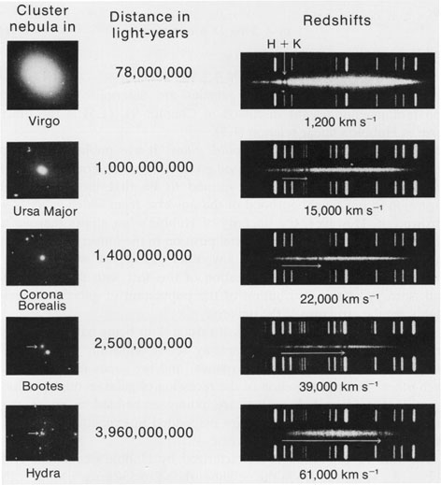
Edwin Hubble’s Discovery
Hubble noticed that the further away the galaxy, the greater the redshift of its light
Redshift is the Doppler Effect for light waves from objects moving away from the observer

Slide 5
What does this redshift mean?
The greater a galaxy’s distance from the observer, the greater its speed moving away from the observer, based on its greater redshift
So, galaxies are getting farther apart as time moves forward, therefore the universe is expanding (getting bigger)

Slide 6
How old is the universe?
Hubble showed that the universe has been expanding for billions of years
The universe was denser in the past
If we “run the film backwards” to when the universe was a single point in space and infinitely dense, that happened about 13.7 billion (13,700,000,000) years ago
This was the “Big Bang”

Slide 7
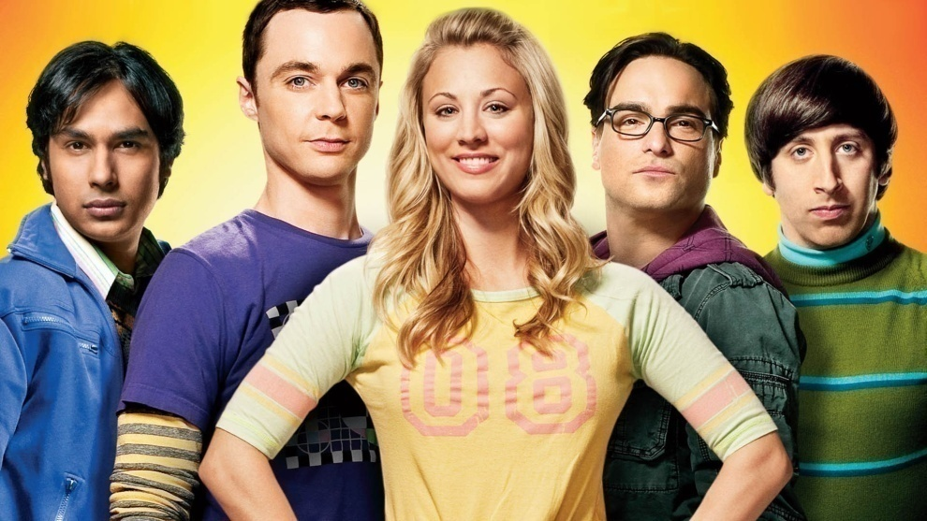
The Big Bang
Most scientists believe the universe as we know it began with the big bang
This created space and time as we know them, so in a real sense, there was no “before the big bang,” and the big bang didn’t happen “in space”
“The Big Bang Theory” TV show is not the same as the real big bang

Slide 8
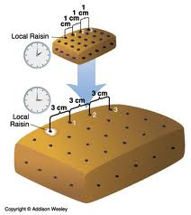
The expanding universe
The space between galaxies expands, not the galaxies themselves
Example: raisins in a loaf of bread.
As the overall loaf of bread expands, the space between raisins increases but the raisins themselves do not expand.

Slide 9
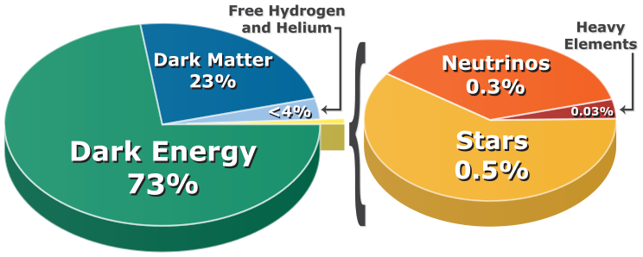
Dark energy and dark matter
We have not directly observed dark energy or dark matter, but scientists think they exist because they are the simplest explanations for two otherwise unexplained behaviors: the accelerating expansion of the universe and the mass that appears to be missing in galaxies based on gravitational effects
In other words, dark energy makes the universe expand faster and faster, and dark matter makes galaxies have the shapes that they do
Most of the universe is made of dark energy, and most of the rest is dark matter

Slide 10
How will the universe end?
Big Freeze?
This is currently the most accepted theory within the scientific community.
Dark energy will cause the universe to expand forever and become very cold as the stars burn out
Big Crunch?
This theory says that the density of the universe is enough for gravity to stop its expansion and begin contracting
After billions of years of contracting, the universe could “crunch” into a single point, possibly causing another Big Bang
This “bang-crunch” cycle could occur repeatedly

Slide 11
The anthropic principle
Scientists have discovered that in order for humans to exist, many extremely unlikely events must have occurred, but they did…
Are we incredibly lucky to exist? Yes and no.
The anthropic principle basically says that because we can consider this question, we must have been made, so its not really luck, but necessity
Basically, “an observed universe must allow the observer to exist"

Slide 12
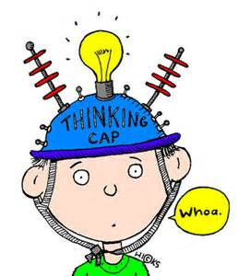
We still don’t know:
What caused the Big Bang?
What is dark matter?
What is dark energy?
Are there other universes connected to ours?
Why is there something instead of nothing?
And many other questions…

