Slide 1
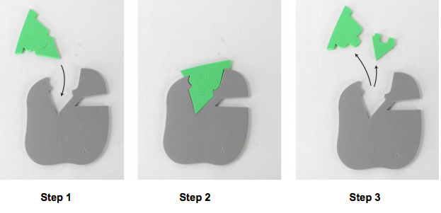
Enzymes in Action (Modeling)
Enzyme Action - Modeling Catabolism

Slide 2
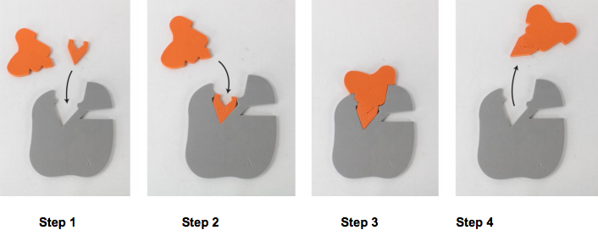
Enzymes in Action (Modeling)
Enzyme Action - Modeling Anabolism

Slide 3
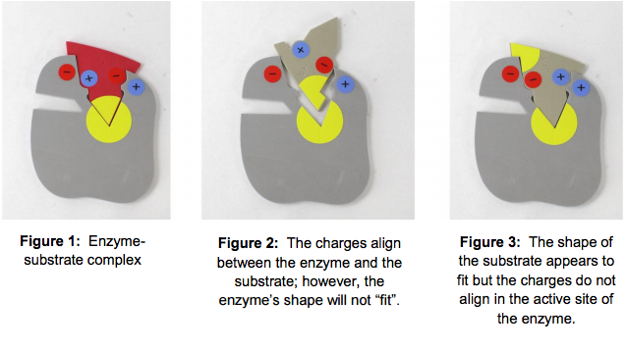
Enzymes in Action (Modeling)
Enzyme Specificity

Slide 4
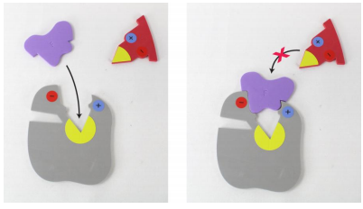
Enzymes in Action (Modeling)
Enzyme Inhibition – Competitive Inhibition

Slide 5
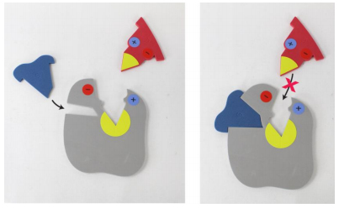
Enzymes in Action (Modeling)
Enzyme Inhibition – Noncompetitive Inhibition

